Slide 1

Endocrine Recap

Slide 2

Name the Disorder…
11-year-old Emily presents to the clinic with increased thirst, frequent urination, and unexplained weight loss over the past month. Her mother reports that Emily has seemed more tired than usual and occasionally complains of blurry vision.
Physical exam findings:
Polydipsia
Polyuria
Weight loss despite good appetite
Fatigue
Occasional blurry vision
Lab Results:
Serum sodium: 144 mEq/L (nl. 136-145 mEq/L)
Serum osmolality: 278 mOsm/kg (nl. 275-295 mOsm/kg)
Urine osmolality: 500 mOsm/kg (nl. 500-850 mOsm/kg)
Urine specific gravity: 1.006 (nl. 1.005-1.030)
Urine glucose: Positive
Blood glucose: 320 mg/dL (nl. 60-110 mg/dL)
HbA1c: 9.2% (nl. 4-6%)

Slide 3
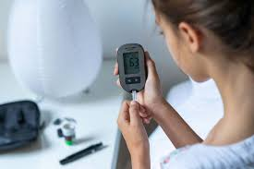
Diabetes mellitus type 1
What are the hallmark signs of T1DM in children?
How would you explain insulin therapy and blood sugar monitoring to the patient and family?
What signs of hypoglycemia should the family watch for, and how should they treat it?

Slide 4
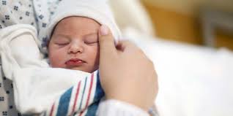
Name the disorder
A 3-week-old infant is brought to the clinic for lethargy, difficulty feeding, constipation, and prolonged jaundice. Mom states that she had a healthy pregnancy and took a prescription of propylthiouracil.

Slide 5

Congenital hypothyroidism
What labs would you expect to be drawn and what results would confirm diagnosis?
Why is early diagnosis crucial for congenital hypothyroidism?
What nursing interventions are necessary to support treatment with levothyroxine?
How would you counsel the family on long-term management, including monitoring growth and development?

Slide 6

Too Much!!
Just Right!!
Too Little!!

Slide 7
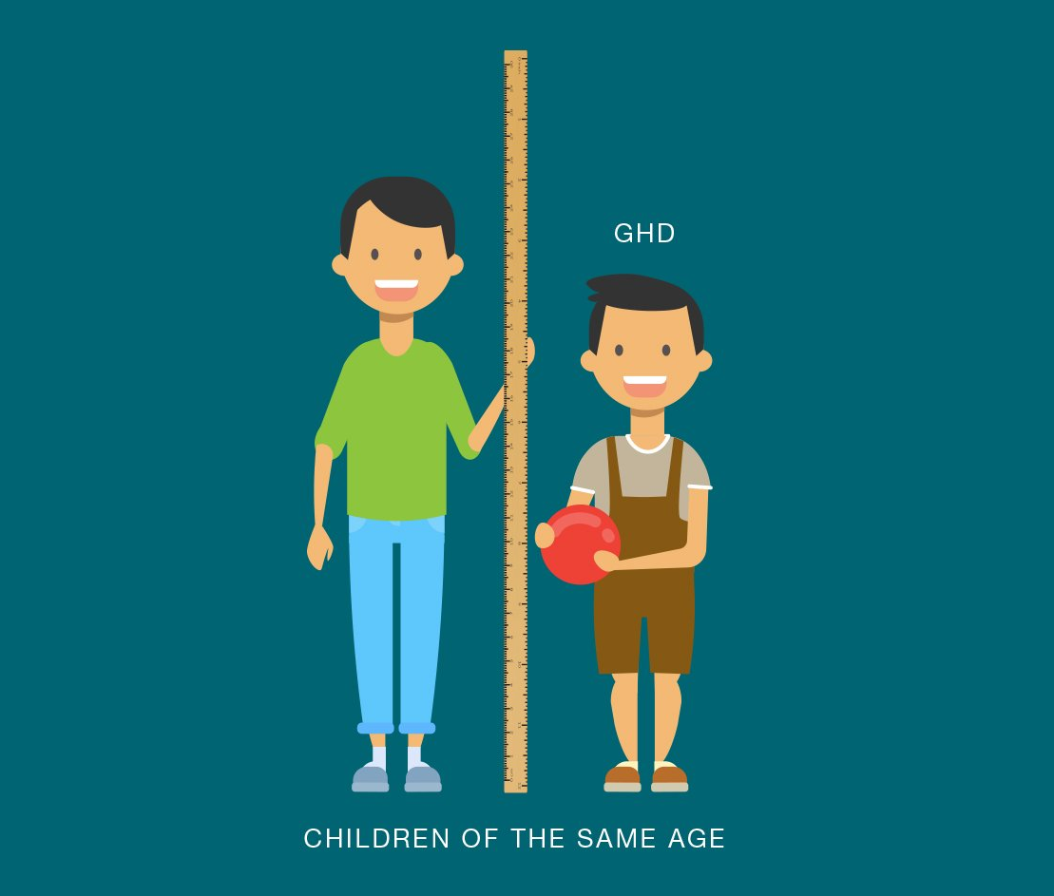
Name the disorder
9-year-old Carlos is brought to the clinic because his parents are concerned about his short stature compared to his classmates. His parents report that he’s smaller than most children his age, though he has a healthy appetite and no other symptoms. The mother and father are taller than the average height and expected him to also be tall.

Slide 8
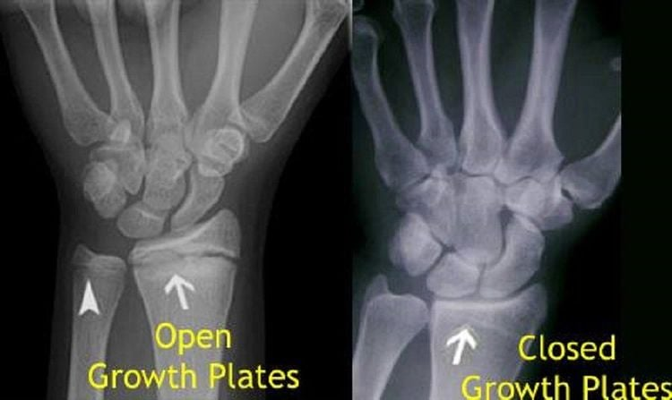
Growth Hormone Deficiency
How would you assess and diagnose growth hormone deficiency in children?
What are common side effects and challenges of growth hormone therapy, and how should these be communicated to the family?
What strategies can help the family ensure adherence to treatment?

Slide 9
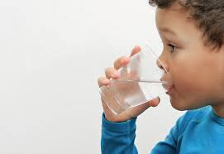
Name the disorder…
8-year-old boy presented to the emergency department with complaints of extreme thirst and frequent urination over the past few days. His mother reports that he has been drinking water constantly and waking up several times at night to go to the bathroom. He has also started bed-wetting, which is unusual for him.
Physical Examination Findings:
  Blood pressure: 90/60 mmHg
  Heart rate: 110 bpm
  Weight: No significant change since his last check-up a month ago
Lab Results:
  Serum sodium: 148 mEq/L (nl. 136-145 mEq/L)
  Urine specific gravity: 1.002 (nl. 1.005-1.030)
  Serum osmolality: 300 mOsm/kg (high-normal)
  Urine osmolality: 100 mOsm/kg (very low)
  Blood glucose: 98 mg/dL (nl. 60-110 mg/dL)
  Urine glucose: negative

Slide 10
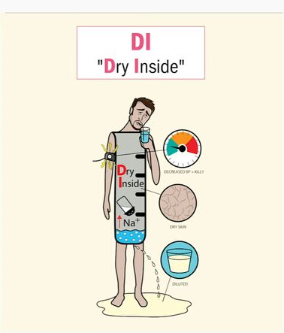
Diabetes insipidus
What signs and symptoms presented by the child are indicative of diabetes insipidus?
What are some potential differential diagnoses that could explain these symptoms?
Based on lab results, what specific findings support a diagnosis of diabetes insipidus?
What are the key nursing interventions and assessments necessary for Noah’s care in the hospital?
How would you explain the purpose and correct administration of desmopressin to Noah’s mother?

Slide 11

Name the disorder…
15-year-old Liam presents with complaints of a racing heart, difficulty sleeping, and irritability. His mother reports he has been more anxious than usual and has occasional tremors. She states that he eats all the time but seems to be “withering away”

Slide 12
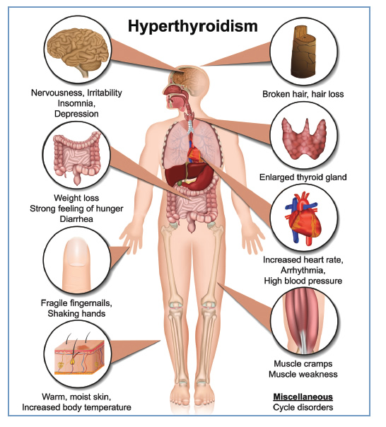
Hyperthyroidism
What are the hallmark symptoms of hyperthyroidism, and how do they differ from hypothyroidism?
What treatment options would you expect for hyperthyroidism in a pediatric patient like Liam?
What client and family education should the nurse provide regarding medication adherence and potential side effects?

Slide 13
Too Much!!
Just Right!!
Too Little!!

